Slide 1
Data driven Dynamic Optimization
of Foundry Sand Testing
Deepak Chowdhary, Director & CEO
MPM Infosoft Pvt. Ltd., India
Developer of ‘SANDMAN ^{(TM)}’ Software
30th April 2019

Slide 2
Data-Centric
Foundry Transformation
Elements of Foundry 4.0
Virtual Engineering
Smart
Sensors
Cloud
Computing
Internet of Things (IOT)
Data Analytics
Outcome
Process Optimization by Integrated Digitalization to make better castings, most efficiently, cost-effectively & profitably

Slide 3
Elements of Industry 4.0
Virtual Engineering
Cloud Computing
Data Analytics
Process Simulation in Software Environment –Flow & Solidification Simulation; Machine Learning tools
Smart Sensors
Internet of Things
Enables equipment to collect process properties data in digital format – Humidity & Temperature sensors
Enables the real time exchange of data – Molding Line and Mixer SCADA, ERP and Compactability Controller Integration; and online measurements
Advanced Machine Learning Algorithm applied on big databases to Optimize foundry process
Centralized data storage, anywhere accessibility, cloud server based programing and computing application which can also be accessed over the internet

Slide 4
Globally, all foundries suffer casting rejections.
Some suffer more, some less.
Rejections are repetitive. So, losses are repetitive.
By rule of thumb almost 50% of total foundry rejects are related to sand.
Back-of-the-envelope calculation:
the cost of a
1%
Molding sand Rejection …
…in an entry-level
24,000
ton/annum foundry…
…Is approx. US$
$225,000
per annum

Slide 5
The ‘Blind’ Spot
The ‘Why’ of Repetitive Rejections -> Reactive Decision Making
Varying Product mix
Shrinking Pool of experts
Varying Sand to Metal ratio
Process Variability
Experiential
Legacy
Lack of return sand estimation
Non-annotated legacy of events
Blind
Spot
Un-validated for accuracy, frequency
The
Un-Met Need
Predict causality of rejections
Un-correlated to rejections
Foundry Data
Reactive to Proactive Decision making
Multiple pockets

Slide 6
Motivation for Data Analytics Decision Support
§ To graduate from reactive decision making
by predicting the Highest Influencing sand properties for rejections of the day
§ To move towards ‘dose-by-need’, variable additions of additives.
Prevent overdosing / under-dosing the system sand. Optimizing consumption
§ To move towards dynamic process consistency:
by predicting and then optimizing the optimal target sand properties
§ To control and reduce rejections
By achieving a Dynamically Stable Operational state of the molding process
Personal Technical Skills
Experiential Knowledge
Process Database
Data
Foundry Data Analytics
Cloud Computing
Profit by Process Optimization

Slide 7
Challenges in Data Analytics based
System optimization
CHALLENGE
ISSUES
REQUIREMENTS
Absence of meaningful and authentic data
Different degrees of variability in different sand properties
Challenge in maintaining the optimal range of sand properties
Right Data at right time and at right frequency
Data capturing Frequency of sand properties depending on their variability
Sand Data Correlated to Casting Rejections

Slide 8
Literature – Foundry Process Optimization & Analytics
Optimization Approach | Researchers / Year | Remark / Summary
Non-linear Optimization Model | D. Chowdhary, et. al., 2018 | Prescriptive model for optimizing sand properties and additives consumption
Artificial Neural Networks and Genetic Algorithms | D. B. Karunakar, et. al., 2007 | Predictive model for mold properties predictions. Genetic model was found to be performing better over Artificial neural network
Response Surface Methodology, and propagation of Error | C. Saikaew, et. al., 2012 | Optimization of molding sand composition for yielding optimal sand properties
Taguchi DOE & Optimization | G. Patil, et. al., 2014 | Process properties are Optimized for minimizing Casting Rejections.
Experimental Design and Bayesian Inference Optimization | H. Khandelwal et. al., 2018 | Relatively new technique applied for Molding composition optimization for Chemically Bonded System
Data Analytics Driven Optimization | S.N. Ramrattan et.al 2016 | Predictive Analytics to Predict Highest Influencing sand properties impacting casting rejections
Optimization by Process Automation | J. Furness et. al. 2018 | Automated Thermal Moisture Analysis, and Automated adjustment of Mixer/Muller energy inputs
GAP
No published research was found which determines the optimum sand testing frequency.

Slide 9
Present Sand Testing Practice
Approach to Decide Tests & their Frequencies
American Foundry Society (AFS) Standard:
AFS has published the standard for sand measurement for green sand foundries [AFS Mold and Core Test Handbook]
Legacy based Frequency:
Based on the sand plant experience and legacy foundry practice, standard testing frequencies are determined
Time for measurement:
Depending upon the time taken for measurement, e.g., Active Clay and LOI take more time to test, than Compactability.
Resource Availability:
Depending upon the number of staff and equipment available for sand testing.

Slide 10
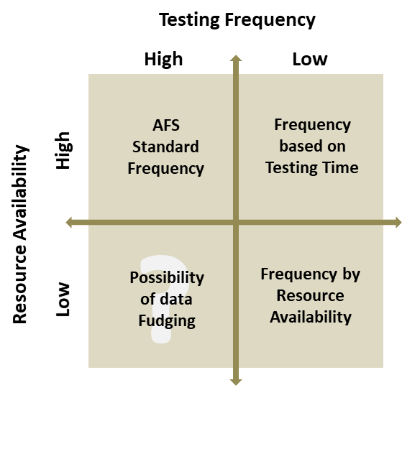
Present Sand Testing Practice
Testing frequency v/s resource availability
BCG Matrix
for testing frequency and resource availability
?
Possibility of data inaccuracy

Slide 11
Present Sand Testing Practice
Limitations
Testing of Sand without sufficient, authenticated and meaningful data insights on how it impacts the casting outcomes (quality) will have time and cost impact.
Absence of scientific methods that can determine optimal frequency of sand testing based on the causality of the inter-relationship of sand properties to casting rejections.
Static testing Frequency in spite of different variability of sand properties for different periods
Sand Testing Frequency for each component is the same irrespective of variable production planning.
LIMITATIONS WITH CURRENT SAND TESTING PRACTICE

Slide 12
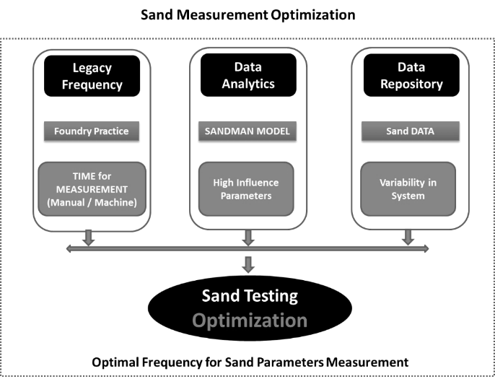
Proposed
Sand Testing Frequency Optimized (STFO) Algorithm
Research Objective
Methodology for Sand Measurement Optimization
“An analytical solution to predict optimal frequency of sand testing properties in a day/shift based on the cause and effect relationship of rejections with sand properties”

Slide 13
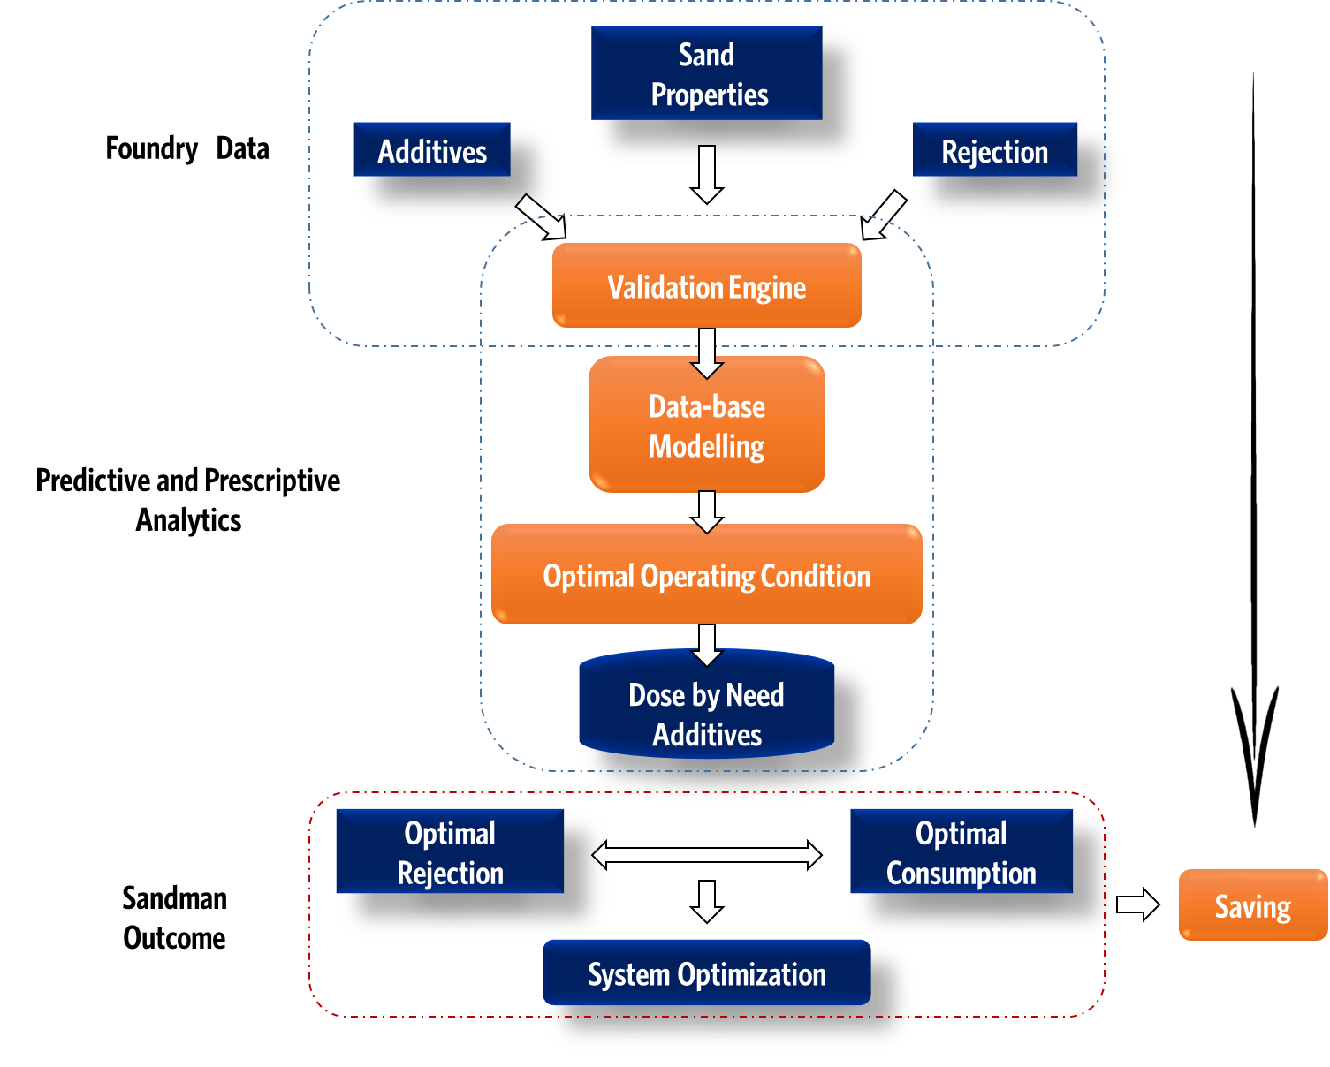
Data Analytics & Cloud Computing for Foundry
STFO Input – 1
SANDMAN, is the world's first (patented) SaaS delivered, Cloud based predictive and prescriptive
analytics software product to enable foundries to optimize their molding sand and as a corollary;
REDUCE CASTING REJECTIONS and OPTIMIZE ADDITIVES CONSUMPTION.
Primary Input
for the algorithm
Machine learning model identifies Highest Influencing Sand Properties (HIP) based on their influence on the casting rejections and suggest the direction of change to reduce the influence

Slide 14
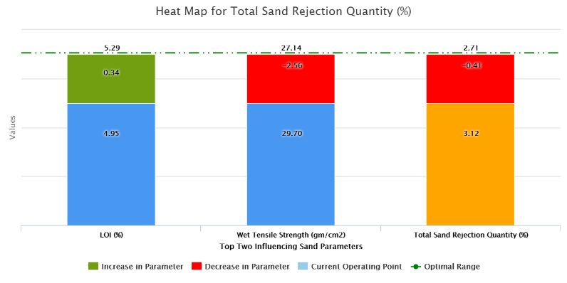
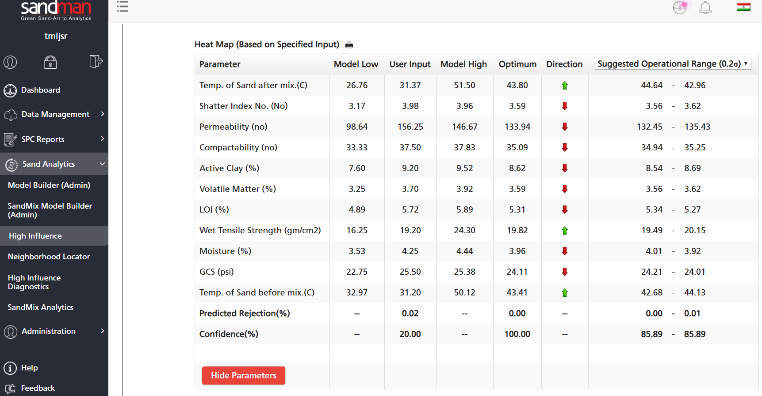
STFO Input – 1
Leveraging HIP:
Predictive Analytics
Predicted rejection, and ‘optimum’ point
Highest influencing properties to tweak
Effect on rejection, if tweaked
Model Input - Average High Influence Factor (model predicted) for past 15 days of the data available, and scaled to 1 to 10.
Weightage Optimization - Properties with high impact factor on rejections are given more weightage

Slide 15
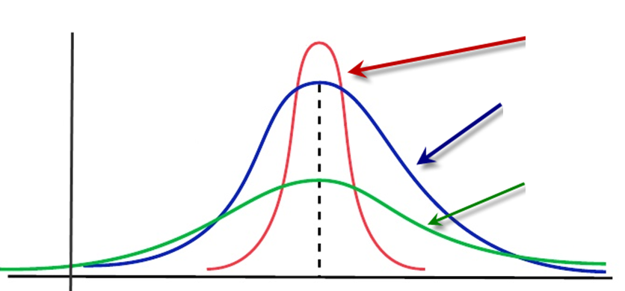
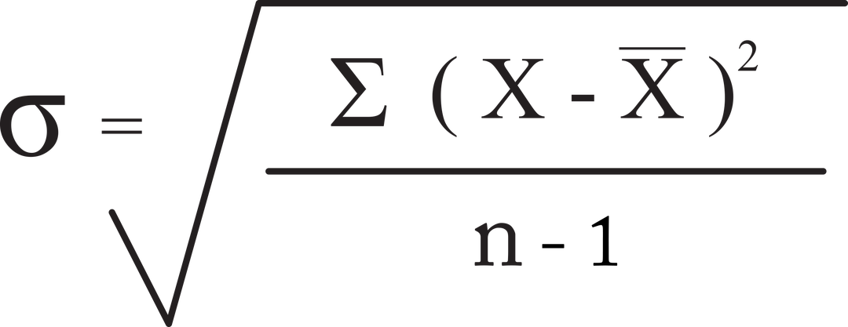
STFO Input – 2
ACKNOWLEDGING Variability:
Low Variability
Important input parameter for the algorithm is the variability measure of each sand properties.
Model inherently computes the standard deviation of each properties from the previous three-month data.
The variability is calculated across the shifts and within the shift and scaled to 1 to 10.
Properties with high variability, are given more weightage and therefore need to be tested greater number of times for focused monitoring and control.
Medium Variability
Frequency
High Variability
Mean

Slide 16
STFO Input – 3
CONSTRAINTs on Time allocation for measurement :
properties | Time for Measurement (min: sec)
 | Manual | Machine | Total
GCS | 00:16 | 00:32 | 00:48
Compactability | 00:25 | 00:25 | 00:25
Active Clay | 10:05 | 105:00 | 105:00
Wet Tensile Strength | 00:16 | 00:45 | 00:61
LOI | 00:35 | 165:00 | 165:00
Moisture | 00:19 | 30:00 | 30:19
Inert Fines | 00:15 | 90:00 | 90:00
Volatile Matter | 00:35 | 10:00 | 10:00
Permeability | 00:15 | 00:14 | 00:29
Shear Strength | 00:15 | 00:30 | 00:45
GFN/AFS | 15:00 | 15:00 | 30:00
Total Clay | 00:15 | 90:00 | 90:00
Temp of sand | 00:10 | 00:10 | 00:10
Friability Index | 00:40 | 00:30 | 00:70
The total time for measuring each sand properties are split into man-hours and machine-hours.
e.g. For example, during LOI testing the manual time required is only 35 sec, whereas the total time of LOI measurement is 165 min.
Majority of the time is taken by the testing equipment.
During intervening test time, the man/hour available is often utilized for measuring other properties.
Time distribution of sand testing practice of a large-scale foundry in India.
The algorithm considers both man and machine time as two separate properties in modelling,
Final optimized solution is being predicted for optimizing both man and machine time available to ensure effective utilization total time.

Slide 17
Case-Study
Optimized frequency solution along with the model input and predicted frequency output for each properties
properties Name | Influencing Factor (no.) | Variability (σ) | Measurement Time (min : sec) | Frequency for Sand Measurement (no./shift)
 |  |  |  | Present | Optimal
GCS (gm/cm2) | 7.7 | 1.2 | 00:48 | 5 | 5
Compactability (no) | 2.3 | 2.0 | 00:25 | 5 | 5
Active Clay (%) | 1.4 | 5.1 | 105:00 | 1 | 1
Wet Tensile Strength (gm/cm2) | 1.0 | 4.3 | 00:61 | 5 | 5
LOI (%) | 2.6 | 10.0 | 165:00 | 1 | 1
Moisture (%) | 2.6 | 2.1 | 30:19 | 5 | 2
Inert Fines (%) | 10.0 | 5.1 | 90:00 | 1 | 2
Volatile Matter (VM) (%) | 1.7 | 6.8 | 10:00 | 1 | 4
Permeability (no) | 2.6 | 4.8 | 00:29 | 5 | 5
Shear Strength (gm/cm2) | 7.8 | 4.3 | 00:45 | 5 | 5
Friability Index (%) | 4.6 | 1.0 | 00:70 | 5 | 4
Temp. of Sand after mix (°C) | 1.6 | 3.0 | 00:10 | 5 | 5
Inert Fines
Moisture
GCS
VM
LOI
1 → 2
5 → 2
5 → 5
1 → 4
1 → 1
Influence: Maximum Variability: Medium Time: High
Influence: Low Variability: Low Time: Medium
Influence: High Variability: Low Time: Low
Influence: Low Variability: High Time: Medium
Influence: Low Variability: Maximum Time: High
Notes:
Maximum frequency : Maximum frequency will be restricted to the average maximum frequency for any parameter in historical data.

Slide 18
Case-Study
Time distribution based on foundries present testing frequency
Time distribution based on foundries optimized testing frequency

Slide 19
STFO Model Validation
properties Name | Absolute Variability
 | Actual | Simulated
GCS (kg/cm2) | 0.09 | 0.09
Compactability (no) | 1.37 | 1.37
Active Clay (%) | 0.49 | 0.49
Wet Tensile Strength (gm/cm2) | 2.16 | 2.16
LOI (%) | 0.31 | 0.31
Moisture (%) | 0.08 | 0.08
Inert Fines (%) | 0.24 | 0.17
Volatile Matter (%) | 0.16 | 0.08
Permeability (no) | 4.47 | 4.47
Shear Strength (kg/cm2) | 0.04 | 0.04
Friability Index (%) | 0.52 | 0.51
Temp. of Sand after mix (°C) | 1.17 | 1.17
A validation experimentation to understand the value proposition
– Compared sand properties variability before and after optimization.
Variance of Previous three-month prepared sand data calculated in its original space and for simulated data-set.
Steps for generating simulated data-set –
Conditional Situation
Optimal frequency = Actual frequency
Optimal frequency < Actual frequency
Optimal frequency > Actual frequency
Data Preparation Method
The data remained unchanged – No Change
The starting data in each-shift is considered and ignored remaining .
The data is imputed by shift-wise mean of that properties
The standard deviation of the properties in the Simulated data is found to be reduced with optimized sand testing frequency

Slide 20
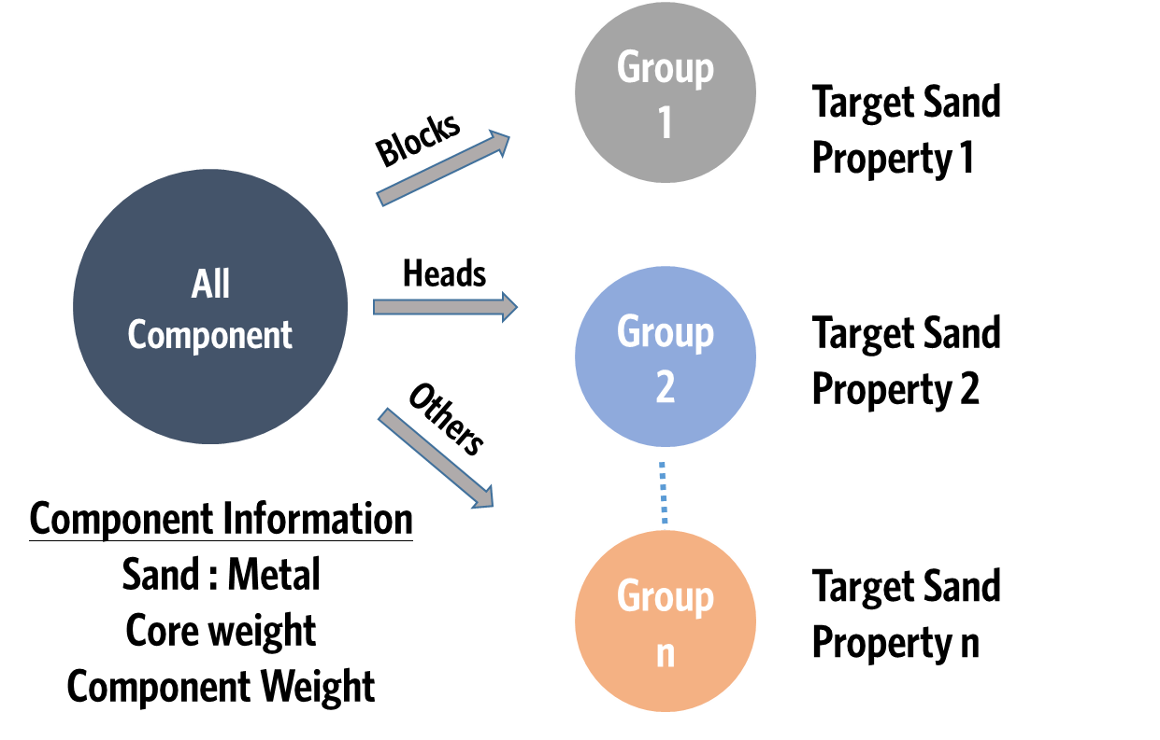
Enhancement in STFO
Group Wise Testing Frequency
Casting based Sand Additive Requirement
Automated Grouping (e.g. S:M ratio) Algorithm
Group-1
Group -’n’
Group Wise Modelling
STFO Inputs –
Group-wise Sand properties Variability
Group-wise Influencing Factor
Optimal Testing Frequency for each Group

Slide 21
Conclusion
Making Sand Testing Dynamic Rather than Static
STFO driven solution helps foundry to generate more meaningful data and will have better sand optimization with controlled process consistency.
STFO Reduces the frequency of the lowest influencing properties or properties with less variability in order to optimize utilization of man / machine time
Direct Utilities of Optimized Sand Testing Frequency
STFO Increases the frequency of tests of the highest influencing properties which will help foundry in closely monitoring the same.
STFO can help in-time decision making by the QC department in controlling influencing sand properties and as a corollary, help improve casting quality.
STFO generates meaningful time-series data for algorithms like SANDMAN® that are designed for sand system optimization by Machine learning and AI methodology
Accurate predictions and prescriptions by data analytics, keeps the system sand optimised consistently, sustainably and scalably.

Slide 22
MPM INFOSOFT and the SANDMAN Team wish to thank “AFS and Distinguished Leaders of the Foundry Industry” for the invaluable opportunity to address and present STFO concept at the “Cast Expo 2019”.

